Slide 1
Measures of Association

Slide 2
Epidemiology
“the study of the occurrence and distribution of health-related states or events in specified populations, including the study of the determinants influencing such states, and the application of this knowledge to control the health problems.” (Porta 2008, page 81)
Notes:
Last week, we talked about this working definition of epidemiology – the reason we are all here.

Slide 3
Terms to introduce:
Absolute differences
Relative differences
Exposed
Unexposed
Relative Risk (Risk Ratio)
Odds Ratio (Relative Odds)
Effectiveness efficacy
Mean difference
Attributable risk in exposed
Etiologic fraction
Excess fraction
Percent attributable risk
Absolute risk reduction
Number needed to treat
Population attributable risk
Point prevalence rate ratio
Multiple testing, correcting from multiple testing,. Directing for multiple testing in the context of confidence intervals
Notes:
These are not necessarily in order. I just need to make sure I hit them all.

Slide 4
Absolute differences
The denominator doesn’t matter.
Differences in occurrence measures
Often preferred when…. Soctrative?

Slide 5
Relative differences
Ratios of occurrence measures
Often preferred when… Socrative?

Slide 6

Blue = Exposed
Orange = Not exposed
Notes:
30 blue and 70 orange
Up to this point, we’ve talked about measuring the occurrence of an event or outcome. We will continue to talk about events and outcomes for the rest of the semester, but today we will also introduce the concept of exposure.

Slide 7
Exposure
The fact or condition of being exposed: such as
the condition of being subject to some effect or influence
E.g., risk exposure to the flu
﻿EXPOSED In epidemiology, the exposed group (or simply, the exposed) is often used to connote a group whose members have been exposed to a supposed cause of a disease or health state of interest or possess a characteristic that is a determinant of the health outcome of interest. (Porta 2008, page 89)
Source: https://www.merriam-webster.com/dictionary/exposure

Slide 8
Exposure
The variable whose causal effect is to be estimated. Examples of exposures assessed by epidemiological studies are environmental and lifestyle factors, socioeconomic and working conditions, medical treatments, and genetic traits. Exposures may be harmful or beneficial—or even both (e.g., if an immunizable disease is circulating, exposure to immunizing agents helps most recipients but may harm those with adverse reactions to the vaccine).
Proximity and/or contact with a source of a disease agent in such a manner that effective transmission of the agent or harmful effects of the agent may occur.
The amount of a factor to which a group or individual was exposed; sometimes contrasted with dose, the amount that enters or interacts with the organism.
The process by which an agent comes into contact with a person or animal in such a way that the person or animal may develop the relevant outcome, such as a disease.
Source: https://www.merriam-webster.com/dictionary/exposure
Notes:
Unexposed is just a person who isn’t exposed.
In epidemiology, it is customary to refer to potential causal characteristics as exposures. Thus, exposure can refer to a behavior (e.g., chronic excessive alcohol consumption), a treatment or other intervention (e.g., participation in an Alcoholics Anonymous program), a trait (e.g., a genotype that affects the metabolism of alcohol), a social condition (e.g., neighborhood prevalence of alcohol retail outlets), or even a comorbid disease or health condition (e.g., infection with hepatitis C virus). (Modern Epi)

Slide 9
2x2 Contingency Table (Crosstab)
 | Outcome + | Outcome -
Exposure + | a | b
Exposure - | c | d
Notes:
This is a typical 2x2 contingency table – also called a crosstab.

Slide 10
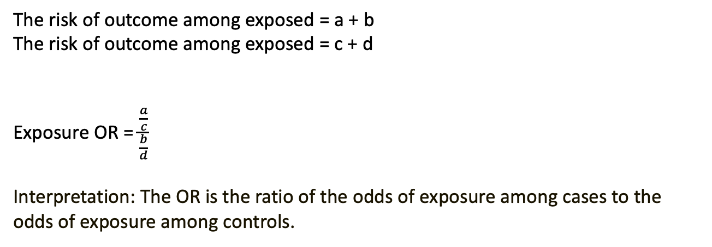
Relative Risk
 | Outcome + | Outcome -
Exposure + | a | b | a + b
Exposure - | c | d | c + d
 | a + c | b + d | a + b + c + d
The risk of outcome among exposed = a + b
The risk of outcome among exposed = c + d
Exposure OR = $\frac{\frac{a}{c}}{\frac{b}{d}}$
Interpretation: The OR is the ratio of the odds of exposure among cases to the odds of exposure among controls.
Notes:
This is a typical 2x2 contingency table – also called a crosstab.

Slide 11
Odds
Notes:
Source: https://www.quora.com/How-do-I-interpret-an-odds-ratio-less-than-1-in-a-logistic-regression

Slide 12
Odds ratio
Say the proportion of applicants getting admitted to Cambridge is 𝑝=0.3p=0.3, therefore the odd of getting into Cambridge is 𝑝1−𝑝=0.30.7=0.4286p1−p=0.30.7=0.4286. This number means for every 0.4286 who are admitted there is 1 who are not admitted, or perhaps more clearly for every 4286 who are admitted there are 10000 who are not admitted.
Now we say the proportion of male getting admitted is 0.2 and the proportion of female getting admitted is 0.3, their respective odds will be 0.25 and 0.4286, then the odds ratio for admission of male over female is 0.250.4286=0.58330.250.4286=0.5833. This translates to, if the numbers of applicants for male and female are the same for every 5833 male who are admitted there are 10,000 female who are admitted if the numbers of applicants for both genders are the same.
Notes:
Source: https://www.quora.com/How-do-I-interpret-an-odds-ratio-less-than-1-in-a-logistic-regression

Slide 13


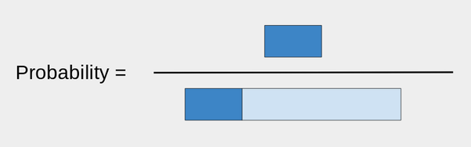
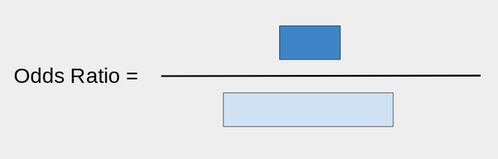
Odds ratio
First take a bar of length 1:
That will be the portion of what did not make it.
Now, take a bar of length r, where r is your ratio. For example, if r was 0.3, I would attach it like so:
The dark blue is the ones that did make it.

Slide 14
OR < 1

Slide 15
Equivalence between exposure OR and disease OR

Slide 16
Add difference between relative and absolute difference example from GPLI presentation

Slide 17
Use Rothman's investment analogy for absolute vs. relative differences
Difference measures such as RD and IRD measure the absolute effect of an exposure. It is also possible to measure the relative effect. As an analogy, consider how to assess the performance of an investment over a period of time. Suppose that an initial investment of $100 became $120 after 1 year. The difference in the value of the investment at the end of the year and the value at the beginning, $20, measures the absolute performance of the investment. The relative performance is obtained by dividing the absolute increase by the initial amount, which gives $20/$100, or 20%. Contrast this investment experience with that of another investment, in which an initial sum of $1000 grew to $1150 after 1 year. For the latter investment, the absolute increment is $150, far greater than the $20 from the first investment, but the relative performance of the second investment is $150/$1000, or 15%, which is worse than the first investment.
Rothman, Kenneth J.. Epidemiology: An Introduction (p. 59). Oxford University Press. Kindle Edition.

Slide 18
Add sensitivity, specificity. Confusion matrix.

Slide 19
Null value
The null value of a measure of association is the value that measure takes when there is no difference between the two groups being compared. (Epi by Design)

Slide 20
Risk difference
“The 5-year risk difference comparing study participants exposed to the contaminant to those who were unexposed was 4%.” (Epi by Design)
for every 1,000 persons who are observed to be exposed to the contaminant (and if those people resemble those we studied), we would expect to likewise observe an additional 40 new cancer cases above the background cancer rate over 5 years. (Epi by Design)
Notes:
Several somewhat technical points about the risk difference measure should be called out here. First, the range of the risk difference is from −1 to +1, inclusive (which we express as [−1, 1]). This is because the highest possible risk is 1, while the lowest is 0; if, as in Table 2.2, the risk in the exposed is higher than in the unexposed, then the risk cannot be higher than 1 − 0 = 1. Similarly, when the risk in the exposed is lower than in the unexposed, then the risk cannot be lower than 0 − 1 = −1. A negative risk difference would occur if the exposure was protective; for instance, if we were considering the association of daily aspirin use with risk of heart attack. Whether the exposure is associated with increased or decreased risk, the risk difference is considered relative to the null value. Again, this is the value which reflects no differences between the two groups being compared. No differences here would mean that the risk in exposed participants and the risk in unexposed participants are the same value P. Therefore, the null for the risk difference is P − P = 0.

Slide 21
Risk Ratio
“The 5-year risk ratio comparing exposed to unexposed study participants is 2.33.” (Epi by Design)
“Over 5 years, we would expect to see 2.33 times the incidence of cancer among exposed study participants compared to unexposed study participants.” (Epi by Design)

Slide 22
Terminology
Term we use | Definition | Other terms used
Incidence Proportion Difference |  | Risk Difference
 |  | Risk Ratio

